Slide 1
Nehalem Bay Vegetation Change

Slide 2
Neakahnie Mountain often blocks summer fog, making a “sunny” valley

Slide 3
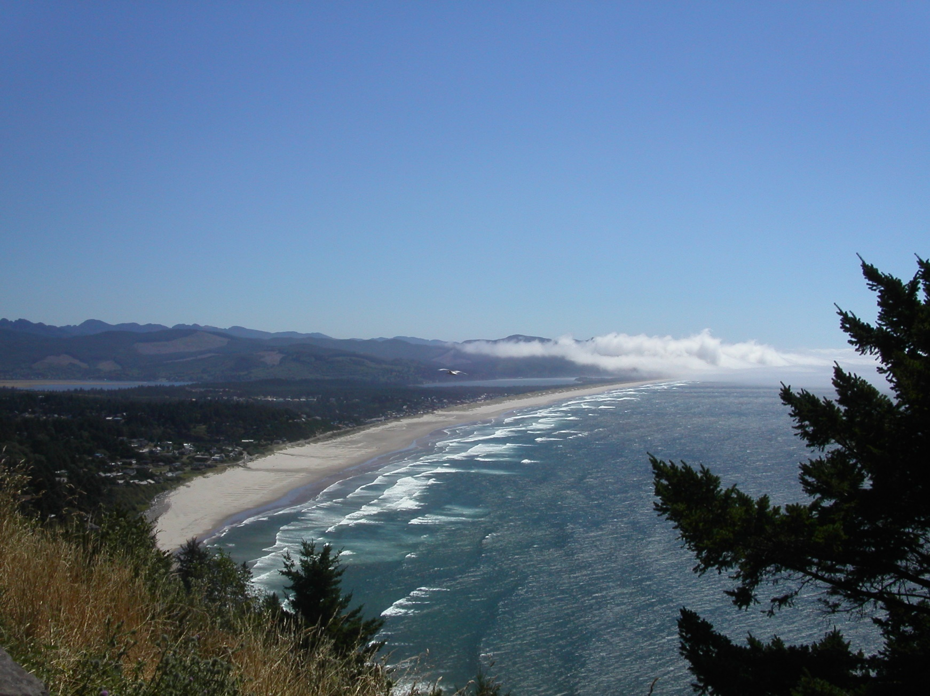
View of Manzanita and Nehalem Spit facing south

Slide 4
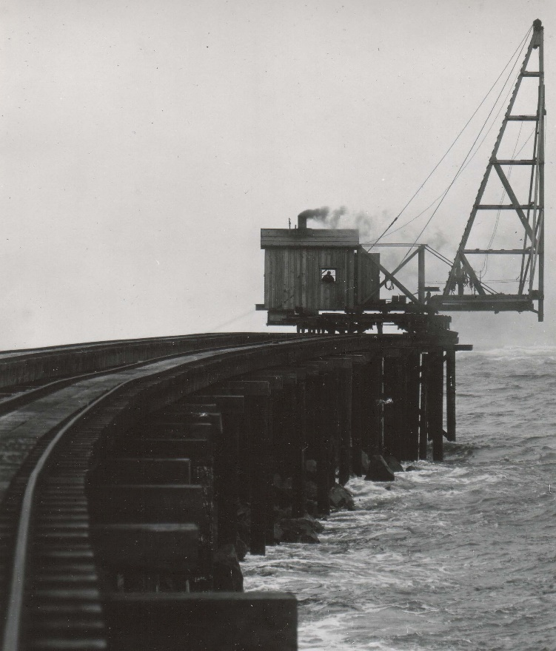

Slide 5
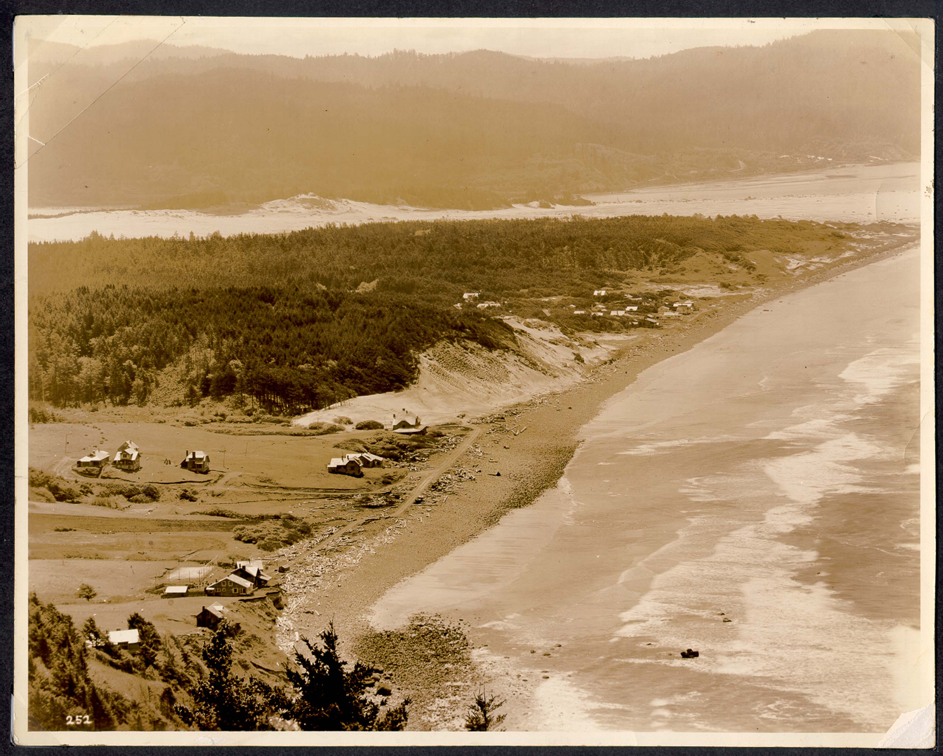

Slide 6
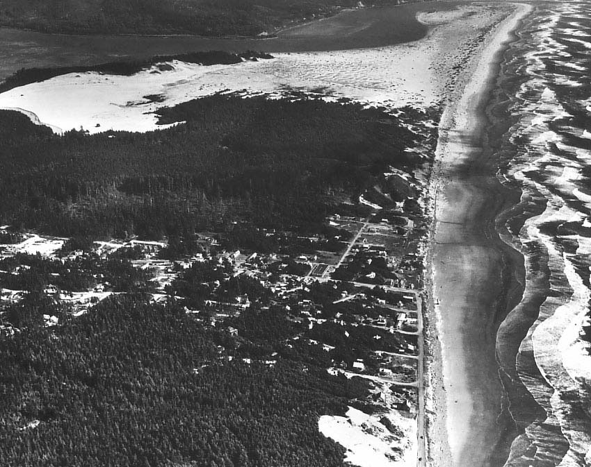

Slide 7
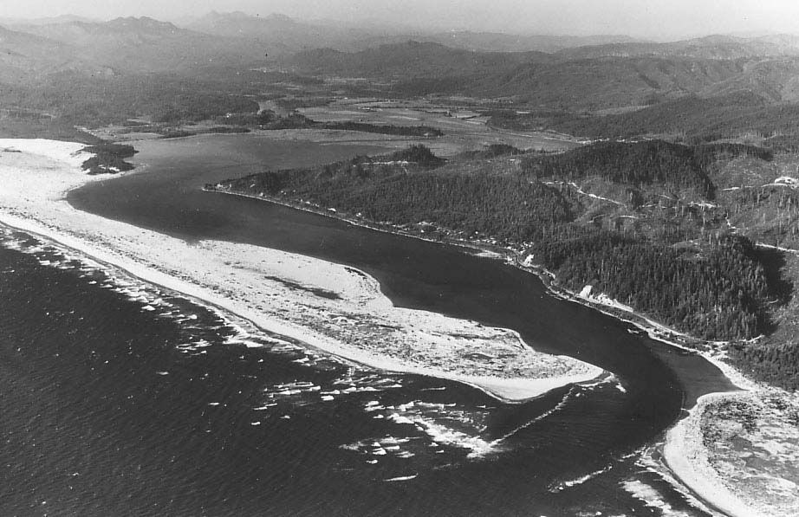

Slide 8
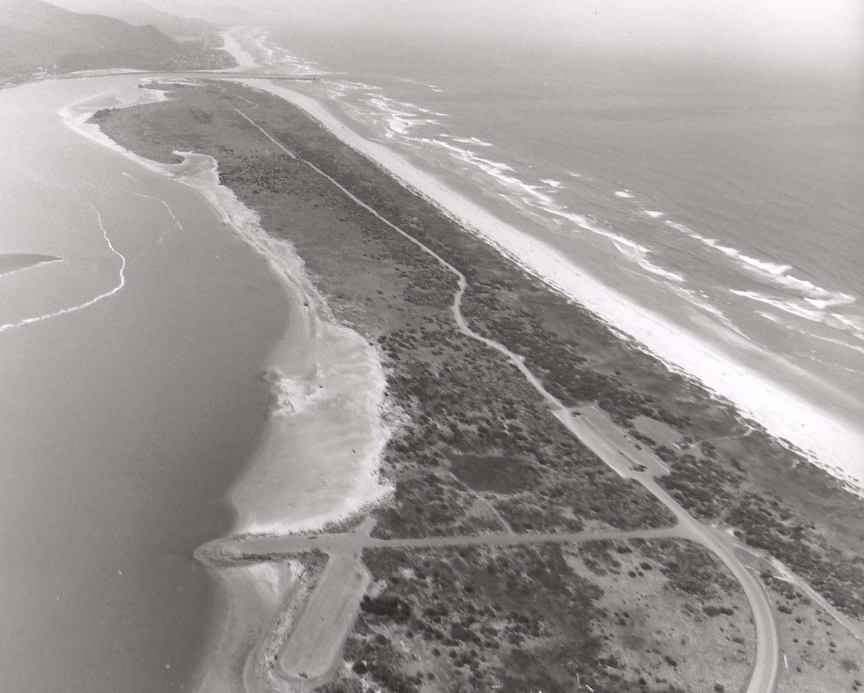

Slide 9
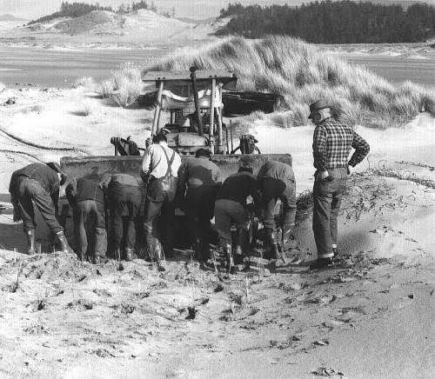

Slide 10
